Slide 1

Erasmus+ Staff Training Week
At SGH Warsaw School of Economics
December 07-11, 2026

Slide 2
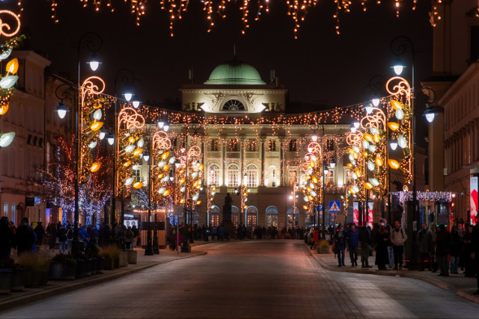
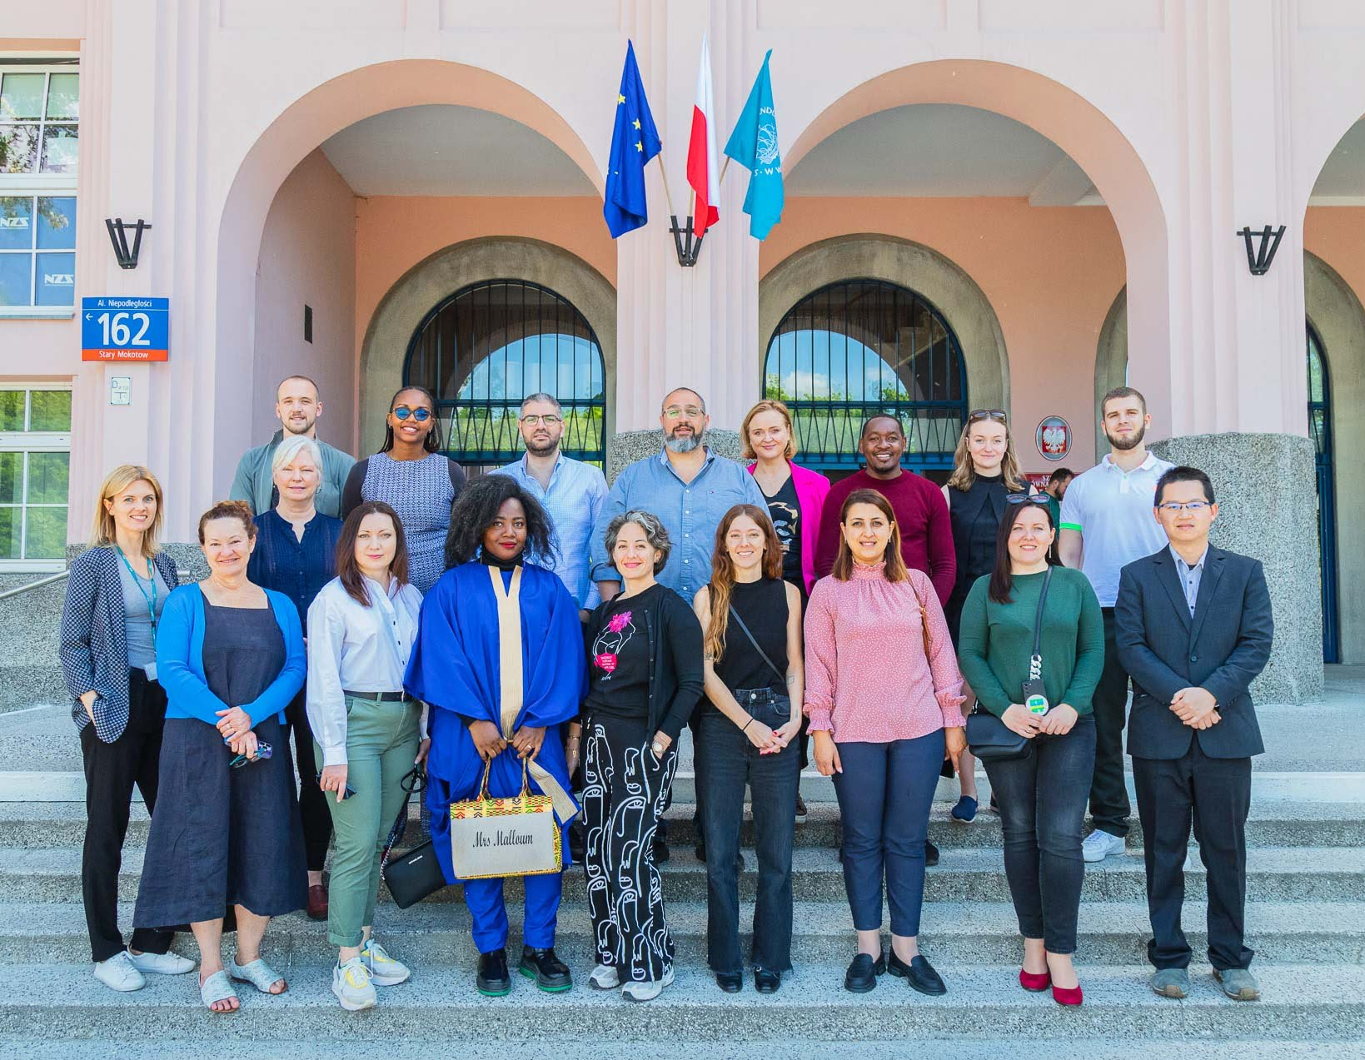
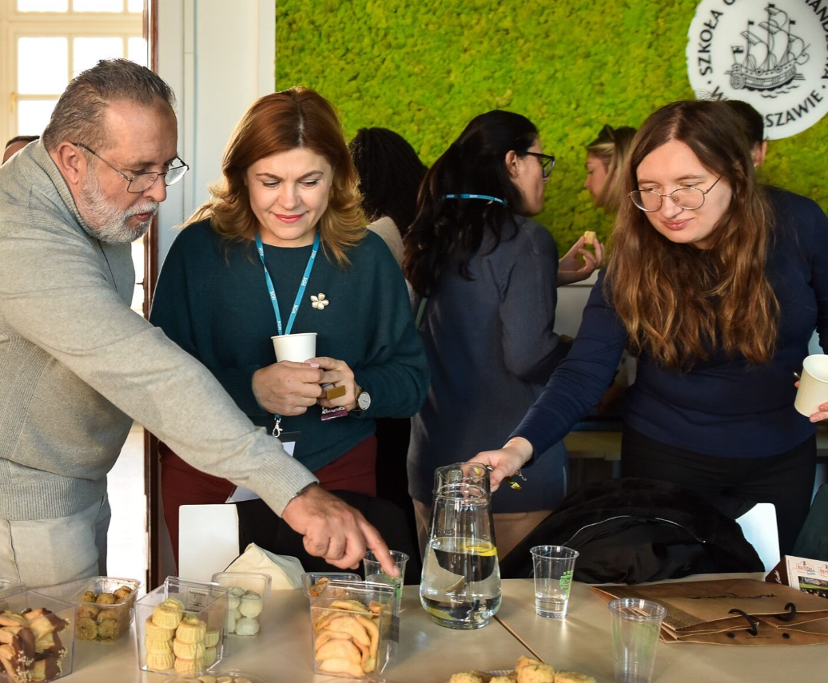
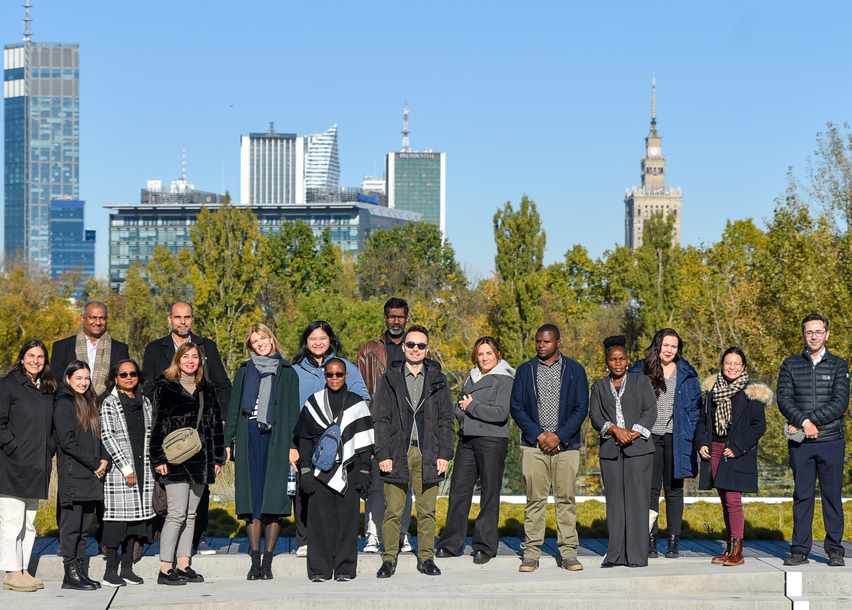
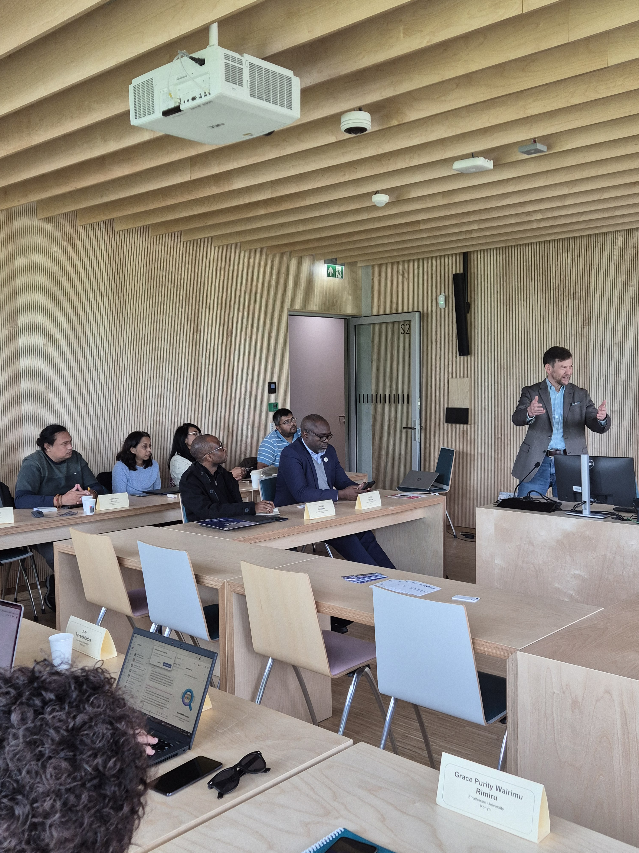
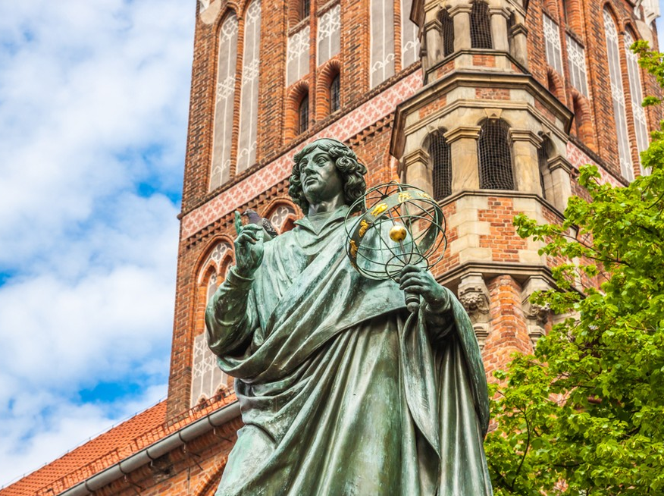
Staff Training
We plan to welcome up to 25 participants within KA131 Erasmus+ countries.
Activities during Staff Week :
sessions and discussions on diverse aspects of Internationalisation of HEI.
networking with SGH staff members
Warsaw walking tour
day trip to Toruń - the city of Copernicus and gingerbreads
presentations of partner universities
Participation in the event is EUR 60,00.
SGH covers:
welcome dinner (Monday)
lunches at SGH on days of the seminars
Day trip to Toruń (except lunch)

Slide 3
Travel arrangements
Participants must arrange their travel and accomodation on their own.
The nearest hotels that we can recommend are:
MDM Hotel – one metro station away from the campus
Metropol Hotel – next to Central Station, 2 metro stations from the campus
Reytan Hotel – 15 minutes walking from the campus
Warsaw also offers a wide choice of apartments for a short stay. All offers are available here: www.booking.com
Currency exchange rate
1 PLN = 0,23 EUR
Chopin Airport (WAW) is very well connected to the city centre. You can take a train or a bus to the central station.
You can buy tickets at the bus stop or on board of buses and trams. Please remember to validate your ticket immediately - fines for lack of a valid ticket are high!
If you prefer a taxi, you can use:
Uber Bolt Freenow iTaxi
The taxi fare to the city centre shouldn’t be more than 65 PLN (15 EUR).
We recommend fixing the price before you get into the cab to avoid scam.
Ticket prices:
20 minutes: 3,40 zł (0,80 EUR)
75 minutes: 4,40 zł (1,00 EUR)
24 hrs : 26 zł (6,20 EUR)
72 hrs: 36 zł (8,60 EUR)

Slide 4
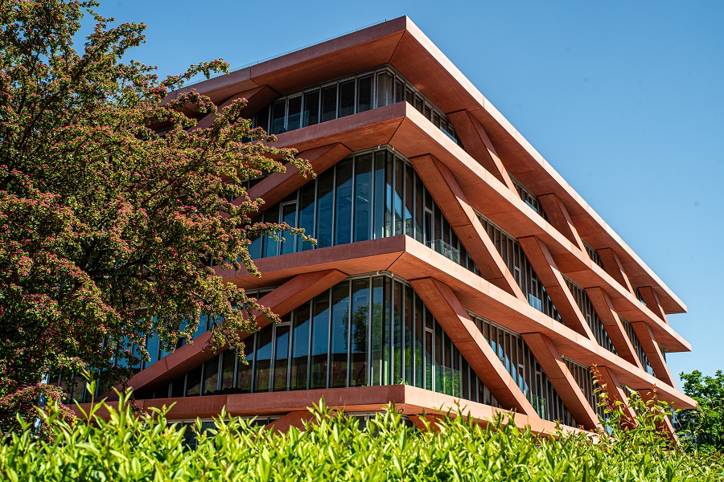
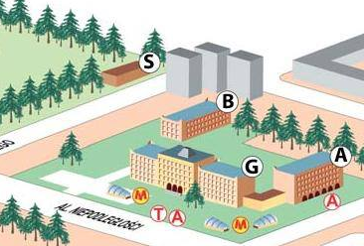
SGH campus
The SGH campus is located near Pole Mokotowskie Metro station, which is only 2 stops from the Central train station.
S Building - Centre of Innovation
Our meetings will take place here
Address: ul. S. Batorego 8, 02-591 Warszawa
A – the oldest SGH building from 1926 (currently under renovation)
B - Library
G - Main Building
S – S Building (Centre of Innovation)
M - Metro station: Pole Mokotowskie
T, A- tram, bus

Slide 5
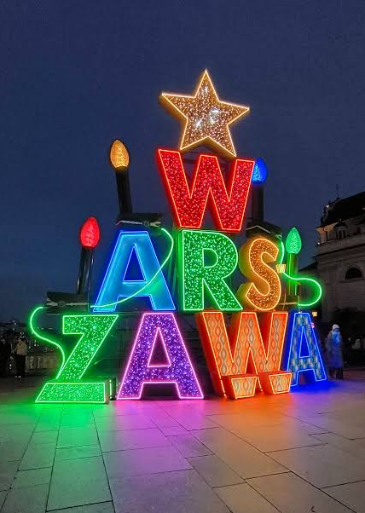
Weather
December is an early-winter month in Poland with temperatures ranging from -2 up to 8 degrees Celsius during the day. Days are short and mostly cloudy, but you’ll be rewarded by the stunning festive lights, that glow all over Warsaw at this time of year.
If we are lucky, we may get some snow, but we cannot promise anything. The climat is being very unpredictible lately!

Slide 6
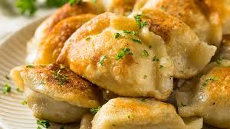
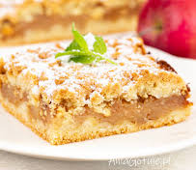
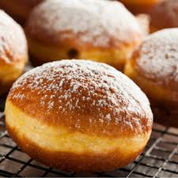
Food
Among the most popular dishes you will find:
Pierogi – dumplings with wide range of fillings. The most popular are the ones with white cheese, potato and onion
Żurek – sour rye soup, often served with boiled egg and a sausage
Kotlet Schabowy – Polish version of viener schnitzel – served often with mushed potatoes and mix of salads
Gołąbki - boiled cabbage leaves wrapped around a filling of minced pork or beef
Placki ziemniaczane – crispy potato pancakes served with sour cream or sauce.
Sweets and pastry:
Pączek – Polish donut with fruit or cream filling; classic flavour: rose jam
Szarlotka – Polish apple pie - tastes best warm with a scup of vanilla ice cream
Kremówka – a cake made from french puff pastry and vanilla cream filling
Piernik – gingerbread cake/ cookie – good idea for a gift from Poland!

Slide 7
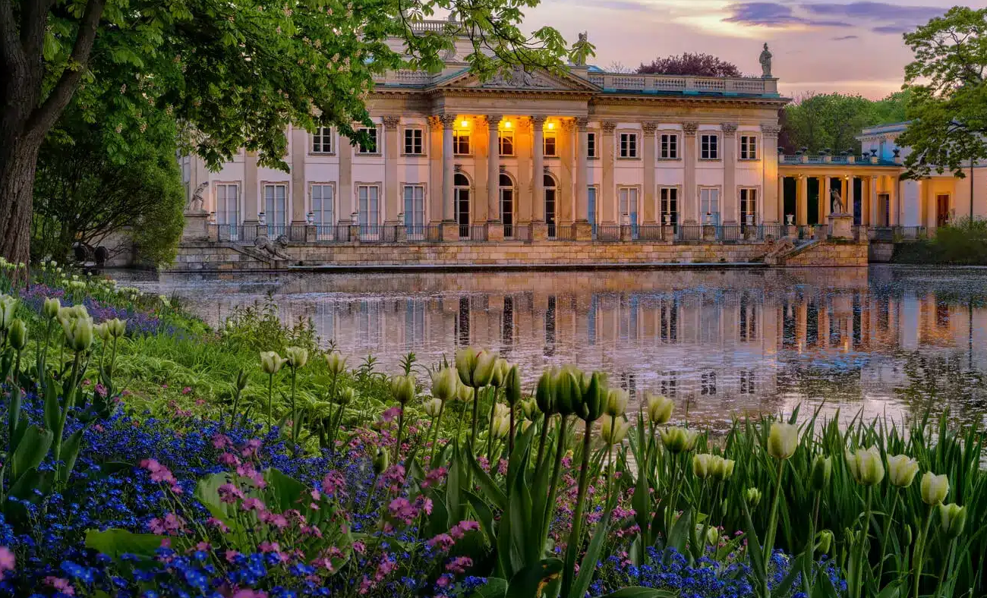
Visiting Warsaw
  Places not to miss:
  Old Town and Royal Castle
  Royal Łazienki Park with Palace on the Isle
  Krasiński Park and The Palace of the Commonwealth
  Varso Tower panoramic view on 53rd floor
  Warsaw Rising Museum
  Polin Museum – the history of Polish Jews
  Chopin Museum
  Museum of King Jan III's Palace at Wilanów
  More information: https://go2warsaw.pl/en/explore-warsaw/

Slide 8
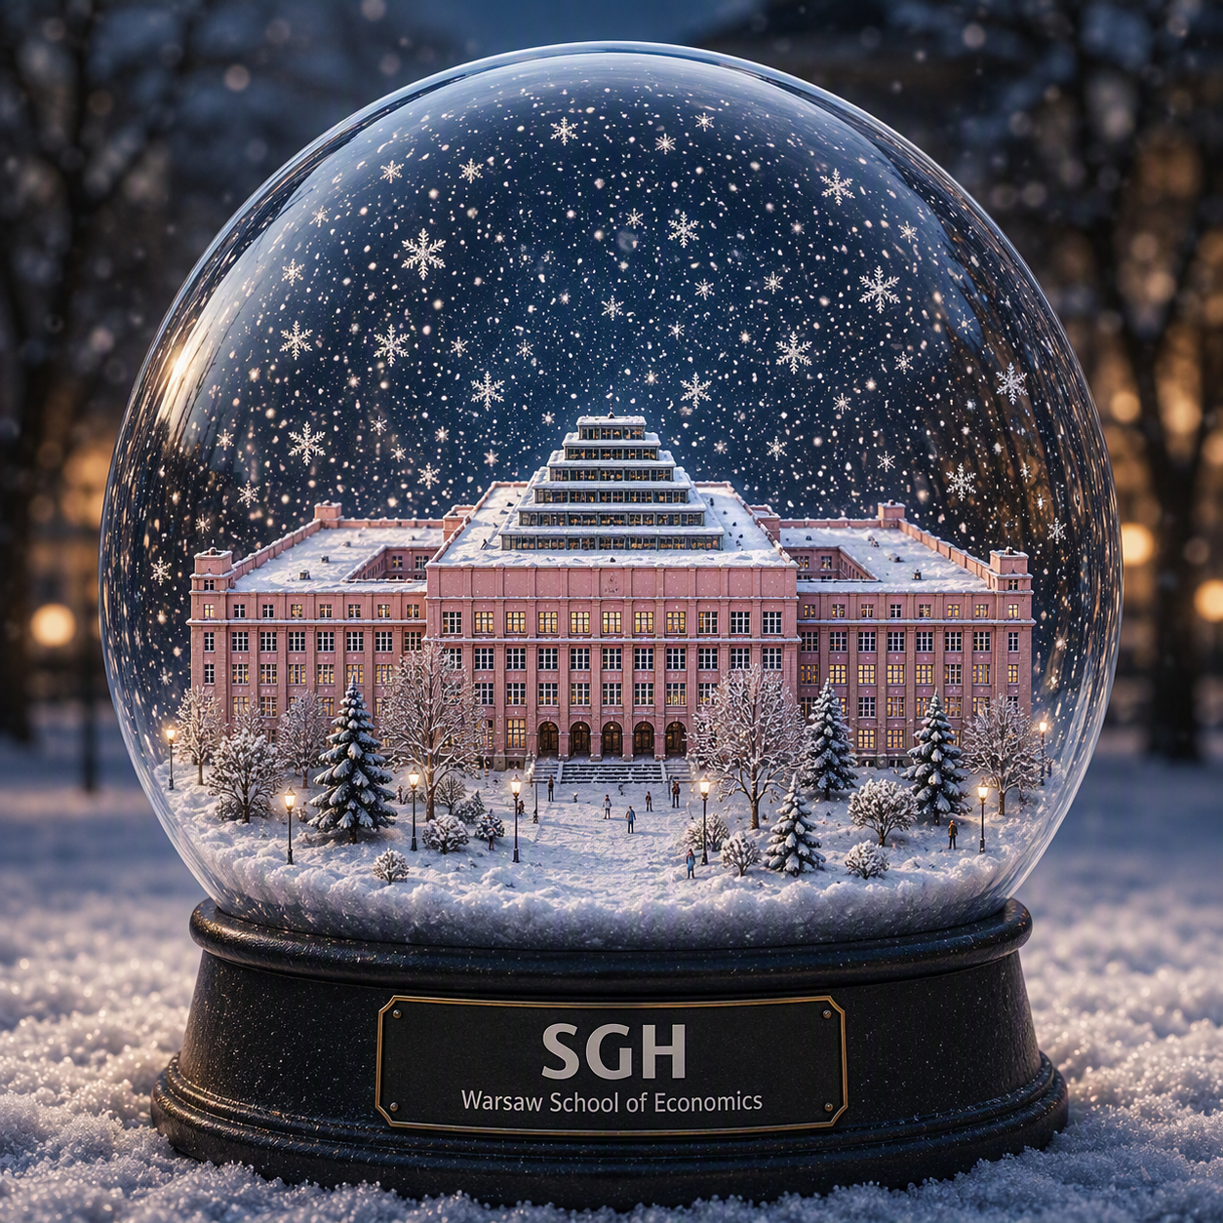
See you in Warsaw!

